Slide 1
Module 15

Slide 2
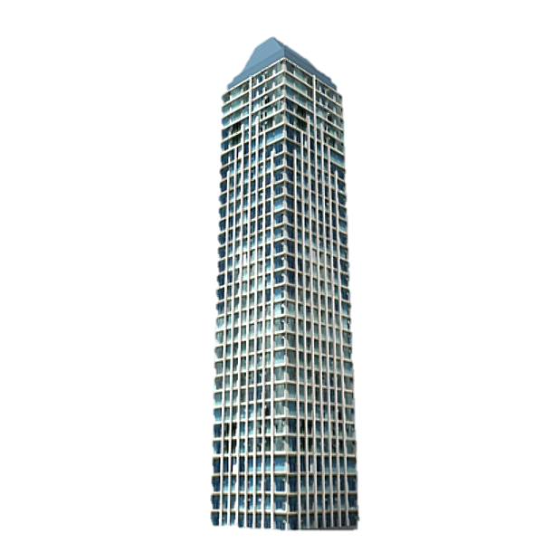
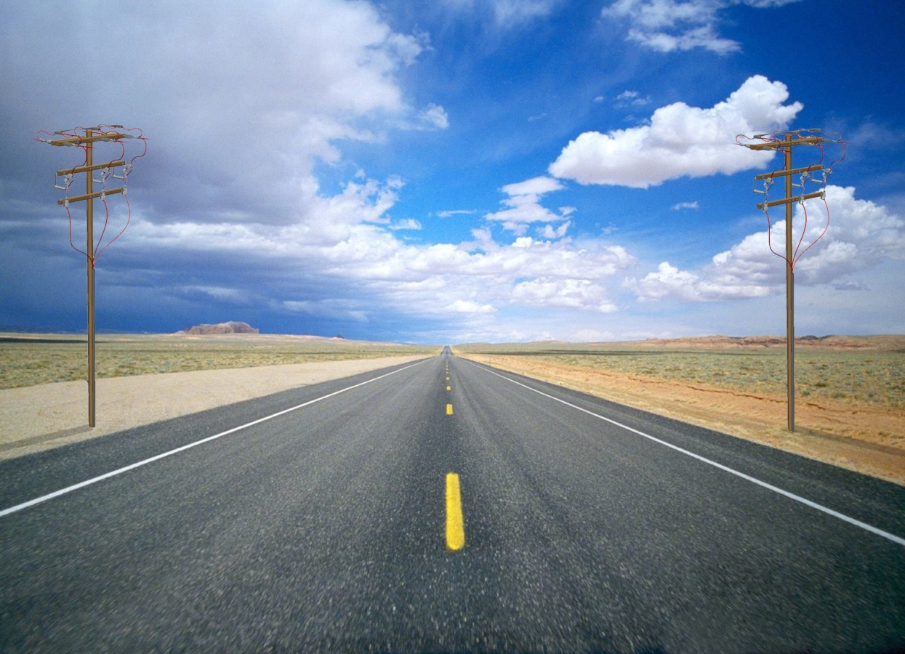

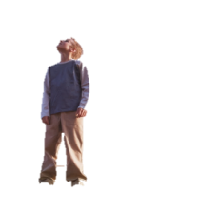


Q. The angles of elevation of the top of a tower from two points at
a distance of 4 m and 9 m from the base of the tower and in the
same straight line with it are complementary.
Prove that the height of the tower is 6 m.
B
Top of Tower
sum of two angles is 90º
Height of the observer is neglected
If one angle is ‘θ’,
then other angle is (90 – θ)
line of sight
line of sight
6 m
Bottom of Tower
θ
90 – θ
D
C
4 m
A
9 m

Slide 3
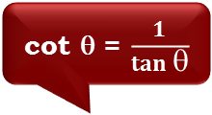
The angles of elevation of the top of a tower
from two points at a distance of 4 m and 9 m
from the base of the tower and in the same
straight line with it are complementary.
Prove that the height of the tower is 6 m.
To prove : h = 6 m
B
For ∠BDA
For ∠BCA
Ratio of opposite side and Adjacent side reminds us of _________
Observe ∠BCA
Ratio of opposite side and Adjacent side reminds us of _________
Observe ∠D
Now, consider ΔBAD
Opposite
side
Consider ΔBAC
Opposite
side
Opposite side →
AB
Opposite side →
AB
‘tan’
‘tan’
Adjacent side →
AD
Adjacent side →
AC
h
Sol.
Let the height of tower (AB) be ‘h’ m
Distance of point C from the
base of tower = 4 m
90 – θ
θ
D
A
C
4 m
Distance of point D from the
base of tower = 9 m
9 m
Adjacent side
In right ΔBAD,
Adjacent side
We know that,
tan (90-θ) = cot θ
Let ∠ACB = θ
AB
tan (90 – θ)
=
So, ∠ADB =
(90 – θ)
AD
cot θ = $\frac{1}{tan θ}$
In right ΔBAC,
h
∴
tan (90 – θ)
=
9
AB
tan θ
h
=
∴
=
AC
cot θ
9
h
1
h
∴
tan θ
=
…(i)
∴
=
4
tan θ
9

Slide 4
The angles of elevation of the top of a tower
from two points at a distance of 4 m and 9 m
from the base of the tower and in the same
straight line with it are complementary.
Prove that the height of the tower is 6 m.
B
h
Sol.
1
h
∴
=
h
tan θ
9
tan θ
=
…(i)
90 – θ
θ
4
D
A
9
5 m
C
4 m
∴
=
tan θ
9 m
h
9
h
∴
=
h
4
∴
36
=
h²
∴
h
=
6
∴
Height of the tower is 6 m

Slide 5
Module 16

Slide 6
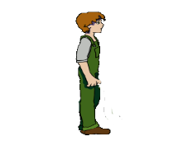

Q.
A 1.5 m tall boy is standing at some distance from a 30 m tall
building. The angle of elevation from his eyes to the top of
building increases from 30º to 60º as he walks towards the
building. Find the distance he walked towards the building.
B
Top of the building
line of sight
line of sight
30m
60º
F
30º
G
D
Horizontal line
1.5m
1.5m
A
E
?
C

Slide 7
Q.
A 1.5 m tall boy is standing at some distance
from a 30 m tall building. The angle of
elevation from his eyes to the top of building
increases from 30º to 60º as he walks towards
the building. Find the distance he walked
towards the building.
B
Observe BG
BG is a part of BA
28.5 m
30m
Sol.
Height of tower (AB) = 30 m
60º
F
30º
G
D
Height of boy (CD) = 1.5 m
?
1.5 m
1.5 m
1.5 m
But, CD =
EF
=
AG
=
1.5 m
A
E
?
C
BG =
AB
–
AG
oFECD is a rectangle
∴
BG =
30
–
1.5
EC = FD
∴
BG =
28.5 m
?
GD =
GF
+
FD
FD =
GD
–
GF
?
?

Slide 8








Q.
A 1.5 m tall boy is standing at some distance
from a 30 m tall building. The angle of
elevation from his eyes to the top of building
increases from 30º to 60º as he walks towards
the building. Find the distance he walked
towards the building.
B
Let us rationalize the denominator
GF belongs to
right angled triangle BGF
For ∠BFG
Ratio of opposite side and Adjacent side reminds us of _________
Observe ∠BFG
Opposite
side
Opposite side →
BG
‘tan’
Adjacent side →
GF
28.5 m
GD
FD =
–
GF
30m
Sol.
?
?
60º
F
30º
G
D
tan 60º =
$$\sqrt{3}$$
1.5 m
1.5 m
1.5 m
In right angled ΔBGF,
A
Adjacent side
C
E
BG
28.5 ×
$$\sqrt{3}$$
tan 60º =
∴
GF
=
GF
$$\sqrt{3}$$
$$\sqrt{3}$$
×
28.5
9.5
∴
$$\sqrt{3}$$
=
28.5 ×
$$\sqrt{3}$$
GF
∴
GF
=
3
28.5
∴
GF
=
$$\sqrt{3}$$
∴
GF
=
9.5
3 m

Slide 9



Q.
A 1.5 m tall boy is standing at some distance
from a 30 m tall building. The angle of
elevation from his eyes to the top of building
increases from 30º to 60º as he walks towards
the building. Find the distance he walked
towards the building.
B
Opposite
side
GD belongs to
right angled triangle BGD
Ratio of opposite side and Adjacent side reminds us of _________
For ∠BDG
Observe ∠D
Opposite side →
BG
‘tan’
Adjacent side →
GD
28.5 m
1
GD
FD =
–
tan 30º =
?
GF
30m
Sol.
In right angled ΔBGD,
F
$$\sqrt{3}$$
?
60º
30º
D
G
BG
1.5 m
1.5 m
1.5 m
tan 30º =
GF
=
9.5
3 m
GD
A
Adjacent side
1
E
C
∴
=
28.5
$$\sqrt{3}$$
GD
∴
GD
=
28.5 m
3
∴
FD
=
32.87 m
FD
=
GD
–
GF
$\sqrt{3}$ = 1.73
∴
FD
=
EC
=
32.87 m
∴
=
–
9.5
FD
28.5
3
3
=
19
∴
Distance walked towards the building is 32.87m
3 m
=
19
× 1.73

Slide 10
Module 17

Slide 11


Q.
A 1.2 m tall girl spots a balloon moving with the wind in a horizontal
line at a height of 88.2 m from the ground. The angle of elevation of the
balloon from the eye of girl is 60º. After some time, angle of elevation reduces to 30º. Find the distance travelled by the balloon during the interval.
B
D
line of sight
line of sight
88.2m
88.2m
P
?
60º
30º
Q
R
Horizontal line
1.2m
E
A
C

Slide 12

Q.
A 1.2 m tall girl spots a balloon moving with
the wind in a horizontal line at a height of
88.2 m from the ground. The angle of
elevation of the balloon from the eyes of
girl is 60º. After some time, angle of elevation
reduces to 30º. Find the distance travelled
by the balloon during the interval.
Find : QR
For ∠BPQ
BA is made up of
BQ and QA
B
Now, let us rationalise the denominator
D
PQ belongs to right angled triangle BQP
Opposite
side
Observe ∠P
Observe ‘BA’
Ratio of opposite side and Adjacent side reminds us of _________
Observe ‘QR’
Opposite side →
BQ
QR is a part of PR
Adjacent side →
PQ
87 m
‘tan’
88.2 m
60º
P
30º
R
Sol.
Height of balloon from the ground
(AB) = 88.2 m
Q
1.2 m
29
3
Height of the girl (PE) = 1.2 m
E
A
C
Adjacent side
QR = PR – PQ
PE =
QA =
RC
= 1.2m
BQ = BA – QA
87
∴
PQ
=
=
88.2
– 1.2
3
$$\sqrt{3}$$
∴ BQ
tan 60º =
?
= 87 m
87
3
In right ΔBQP,
∴
PQ
=
×
3
3
BQ
tan 60º =
87
3
PQ
∴
PQ
=
87
3
∴
3
=
∴
PQ
PQ
=
29
3

Slide 13


Q.
A 1.2 m tall girl spots a balloon moving with
the wind in a horizontal line at a height of
88.2 m from the ground. The angle of
elevation of the balloon from the eyes of
girl is 60º. After some time, angle of elevation
reduces to 30º. Find the distance travelled
by the balloon during the interval.
For ∠P
B
Opposite
side
D
Observe ∠P
Ratio of opposite side and Adjacent side reminds us of _________
PR belongs to
right angled triangle PRD
Opposite side →
DR
‘tan’
87 m
Adjacent side →
PR
1
tan 30º =
?
88.2 m
$$\sqrt{3}$$
60º
P
30º
R
Sol.
In right ΔPRD,
29
3
Q
1.2 m
DR
Adjacent side
tan 30º =
E
A
C
PR
QR = PR – PQ
1
87
∴
=
3
PR
58
× 1.73
∴ QR
=
∴
PR
=
87
3
∴ QR
100.34 m
QR =
PR
– PQ
=
$\sqrt{3}$ = 1.73
Distance travelled by the balloon is
100.34 m
∴
QR
=
87
3
–
29
3
QR
58
3
∴
=

Slide 14
Module 18 Solved Example 3

Slide 15
Module 19

Slide 16

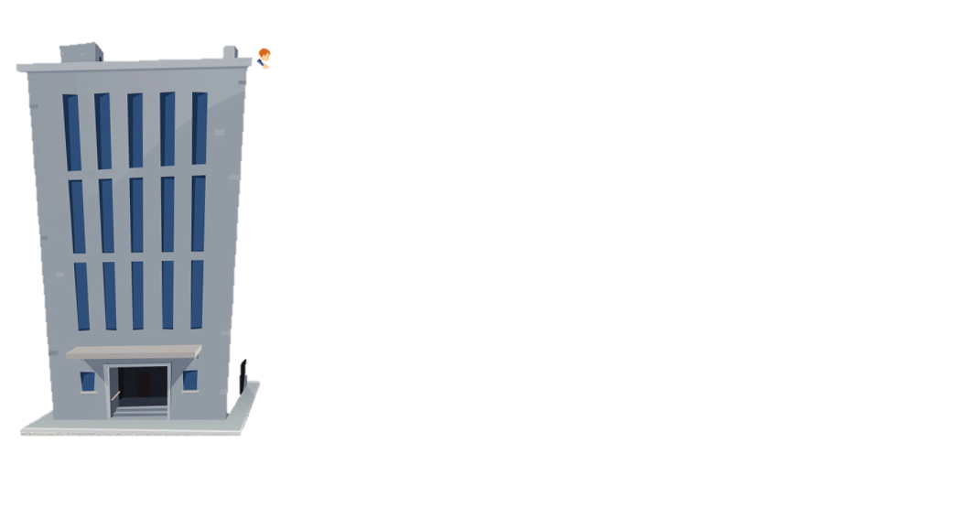
Two buildings are in front of each other on either side of a road of
width 10 metres. From the top of the first building, which is
30 metres high, the angle of elevation of top of the second is 45º .
What is the height of the second building ?
Top of the
second building
C
line of sight
Observer
45º
A
E
Horizontal line
?
30 m
B
D
10 m

Slide 17
Two buildings are in front of each other
on either side of a road of width 10 metres.
From the top of the first building, which is
30 metres high, the angle of elevation of
top of the second is 45º .
What is the height of the second building ?
CD is made up of CE and ED
For ∠CAE
Ratio of opposite side and Adjacent side reminds us of _________
Observe ∠CAE
C
Consider ΔCEA
Opposite side →
CE
Observe CD
‘tan’
Opposite
side
Adjacent side →
AE
A
45º
Sol.
AB and CD represents the heights of two buildings.
E
10 m
AB = 30 m
BD represents the width of the road.
Adjacent side
BD = 10 m
30 m
30 m
A represents the position of the observer.
∠CAE is the angle of elevation.
∠CAE = 45º
CE
∴
1
=
oABDE is a rectangle.
10
AB = DE = 30 m
∴
CE
=
10 m
B
10 m
D
?
tan 45º =
1
BD = AE = 10 m
CD
=
CE
+
ED
In right angled ΔCEA,
CE
∴
CD
=
10
+
30
∴
The height of the second
building is 40 m
tan 45º =
AE
∴
CD
=
40 m

Slide 18
Thank You

